Slide 1

Domain Name System
Speaker ：71117317胡昱
Teammates ：71Y17114王嘉磊
71Y17118黄旭

Slide 2
Content
What’s DN, DNS and ‘DNS’ ?
01
In this part, I will tell you not only what is Domain Name, Domain Name System and Domain Name server and the relationship between them, but also why we use them.
How DNS work ?
02
In this part, I am going to tell you UDP message format of DNS and the working process of DNS.
DNS and National Security
03
In this part, I will tell you how DNS affects national security and the opportunities and opportunities that China has faced.

Slide 3
1
What’s DN, DNS and ‘DNS’ ?
In this part, I will tell you not only what is Domain Name, Domain Name System and Domain Name server and the relationship between them, but also why we use them.

Slide 4
01
Besides your parents, whose telephone number do you know ?
Answer: 😂 😂 😂 😂 😂 😂
We know that there are only 11 mobile phone numbers. So what if I want you to remember the 32-bit IP address ?
Answer: 😭 😭 😭 😭 😭 😭

Slide 5
01
14.215.177.39 (IP)
www.baidu.com (DN)
120.34.20.25 (IP)

Slide 6
Structure of domain name
01
Host Name + Domain Name = Domain Name Address
Top-level domain names (ICANN)
root
gTLD: com, net, org, int, gov(USA), mil(USA)…
ccTLD: cn(CHINA), us(USA), uk(England)…
Infrastructure Domain: arpa…
com
edu
cn
…
gov
Sub domain names (Under cn)
ibm
…
sun
com
edu
…
fj
Provinces(34): bj(Beijjing), fj(Fujian)…
General: com, net, org, gov, edu, ac…
seu
tsinghua
…
pku
Tertiary domain names (Under edu)
www
email
…
ftp
seu, tsinghua, pku…
……
www.seu.edu.cn
……

Slide 7
01
domain name SYSTEM
Domain name system is a service of Internet for TCP / IP applications. It is used to convert the domain name address convenient for people to IP address.
DOMAIN NAME SYSTEM
For example, when we enter the domain name address (www.baidu. com) in the browser address bar, confirm the visit, and then it will convert the domain name address to the corresponding IP address information through DNS, and then it can really access the website by IP address (14.215.177.39).

Slide 8
01
domain name SYSTEM
In fact, Domain Name System is a distributed database.
  According to the hierarchical tree structure of the domain name space of the domain name system, it is divided into different zooms according to the subtree. Each zoom can be regarded as a manager of this part of the nodes in the hierarchy.
root
ICANN
com
edu
cn
…
gov
ibm
…
sun
com
edu
…
fj
CNNIC
seu
tsinghua
…
pku
SEU Network Center
www
email
…
ftp

Slide 9
01
domain name SYSTEM
In fact, Domain Name System is a distributed database.
  DNS enables a group of servers located in different nodes to work together to solve the maps between domain name and IP address problem.
  So there can be two or more DNSs in a zone, so that even if one DNS fails, the other DNSs can still provide information normally.
  So users can query the nearest DNS to improve query speed.
  ……

Slide 10

01
domain name SERVER
The so-called domain name server is actually the host with running the domain name system. It is also a distributed database.
Functions:
  Realize the maintenance of domain
  name address.
  Mapping domain name address and
  IP address.
  Ensure the uniqueness of domain
  name address in the Internet.
  ……
Domain Name
System
In my opinion, we do not need to distinguish these two DNS.

Slide 11
2
How DNS work ?
In this part, I am going to tell you UDP message format of DNS and the working process of DNS.

Slide 12
02
Domain Name Server
TCP
UDP
Port:53
Port:53
Domain Name Server
User

Slide 13
02
UDP message format of DNS
0
15
16
31
Identification | Sign
Question number | Resource number
Number of authorized resource records | Number of additional resource records
Query question
Answer
authority
Additional information
12Bytes
The identity field is set by the client and returned by the server. The client uses it to determine whether the response matches the query.

Slide 14
02
UDP message format of DNS
0
15
16
31
Identification | Flag
Question number | Resource number
Number of authorized resource records | Number of additional resource records
Query question
Answer
authority
Additional information
12Bytes
1
4
1
1
1
1
3
4
QR | Opcode | AA | TC | RD | RA | (Zero) | Rcode
QR: 0 means query message,
1 means response message.

Slide 15
02
UDP message format of DNS
0
15
16
31
Identification | Flag
Question number | Resource number
Number of authorized resource records | Number of additional resource records
Query question
Answer
authority
Additional information
12Bytes
1
4
1
1
1
1
3
4
QR | Opcode | AA | TC | RD | RA | (Zero) | Rcode
Opcode: 0 (Usualy) means standard query,
1 means inverse query,
2 means server status request.

Slide 16
02
UDP message format of DNS
0
15
16
31
Identification | Flag
Question number | Resource number
Number of authorized resource records | Number of additional resource records
Query question
Answer
authority
Additional information
12Bytes
1
4
1
1
1
1
3
4
QR | Opcode | AA | TC | RD | RA | (Zero) | Rcode
AA indicates "authorized response" .
CC indicates "truncated" .

Slide 17
02
UDP message format of DNS
0
15
16
31
Identification | Flag
Question number | Resource number
Number of authorized resource records | Number of additional resource records
Query question
Answer
authority
Additional information
12Bytes
1
4
1
1
1
1
3
4
QR | Opcode | AA | TC | RD | RA | (Zero) | Rcode
RD indicates "recursion desired" .
0 means recursive query and 1 means iterative query.

Slide 18
02
UDP message format of DNS
0
15
16
31
Identification | Flag
Question number | Resource number
Number of authorized resource records | Number of additional resource records
Query question
Answer
authority
Additional information
12Bytes
1
4
1
1
1
1
3
4
QR | Opcode | AA | TC | RD | RA | (Zero) | Rcode
RA indicates ”available recursion" .

Slide 19
02
UDP message format of DNS
0
15
16
31
Identification | Flag
Question number | Resource number
Number of authorized resource records | Number of additional resource records
Query question
Answer
authority
Additional information
12Bytes
1
4
1
1
1
1
3
4
QR | Opcode | AA | TC | RD | RA | (Zero) | Rcode
Rcode: 0 means no error,
1 means domain name error.

Slide 20
02
UDP message format of DNS
0
15
16
31
Identification | Sign
Question number | Resource number
Number of authorized resource records | Number of additional resource records
Query question
Answer
authority
Additional information
12Bytes
Each question has a query type. The most commonly used query type is type A, which indicates the IP address for which the query name is expected. But the PTR type query requests a domain name corresponding to an IP address.

Slide 21
Working process of DNS
(recursive queries)
02
For example, A MIT student wants to access www.seu.edu.cn
User.mit.edu ask MIT DNS to resolve www.seu.edu.cn :
root
User Host
MIT DNS
MIT DNS
root
edu
com
cn
…
gov
MIT DNS
dns.cn
…
…
mit
Stanford
com
edu
fj
MIT DNS
dns.edu.cn
MIT DNS
dns.seu.edu.cn
user
seu
tsinghua
…
pku
MIT DNS
User Host
www
email
…
ftp
A total of 10 UDP messages are used.

Slide 22
3
DNS and National Security
In this part, I will tell you how DNS affects national security and the opportunities and opportunities that China has faced.

Slide 23
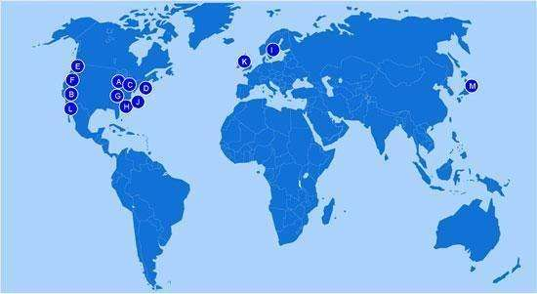
03
We all know the importance of the root domain server. However, in the age of IPv4, the situation is as follow.

Slide 24
03
There are 1 root domain name server and 9 sub roots domain name servers in American, so they can do these:
  During the Iraq war, ICANN terminated the application and resolution of its national domain name .iq for the reason of Iraq's turbulence. Iraq was killed by American in the virtual world.
  Through the "access redirection technology", the owner of the root domain name server is fully capable of transferring the user's access to an important domain name (such as a bank) to the IP address he wants, thus stealing information.
  Monitor network usage in other countries.
Although in 2003-2004, China mirrored the data on a root domain name server to ensure the security of the domestic Internet, it was still far from enough.

Slide 25
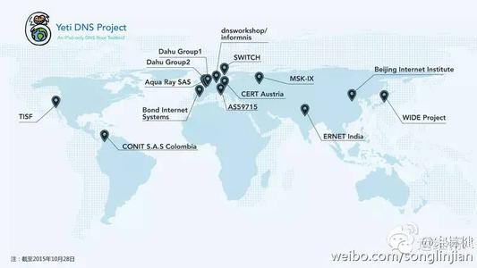
03
However, in the age of IPv6, the Yeti DNS project come into the world.

Slide 26
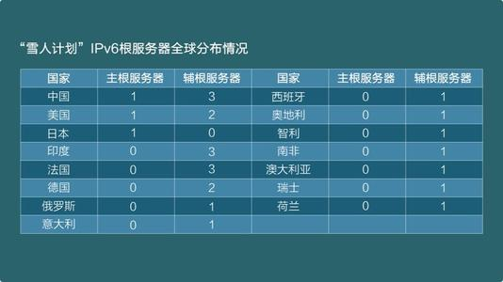
03
Under the new Internet system, China will have four root servers. (including one root domain name server)

Slide 27
Thank You
.
.
.

